Slide 1

Exercises
Let us practice the concepts learned by solving some problems.

Slide 2
Problem Statement
  Draw a flowchart and write the pseudocode to accept 5 numbers and display the total number of odd and even numbers.
  Allocated time to solve the problem is 10 minutes.
Notes:
Explain the meaning of pseudocode. Using the example of adding two numbers explain how easily an pseudocode can be rewritten to program using a specific programming language.

Slide 3
Problem Statement (Contd.)
Answer the following questions:
  What should be the size of an array for the given problem?
  What will be the last index of an array?
  How many variables you need other than an array to solve the problem?
  What is the expected output?
  How many times the loop should run?
Notes:
Explain the concept of dry run. Tell that it will help to know the output of a program by taking sample values.

Slide 4
Solution
Start
numeric nNum, nOdd, nEven, nCtr
nCtr = 1, nOdd = 0, nEven = 0
Accept nNum
Is nNum % 2 == 0 ?
Yes
nEven = nEven + 1
No
nOdd = nOdd + 1
nCtr = nCtr + 1
Yes
Is nCtr <= 5 ?
No
A
Notes:
Explain the meaning of pseudocode. Using the example of adding two numbers explain how easily an pseudocode can be rewritten to program using a specific programming language.

Slide 5
Solution (Contd.)
A
Display nOdd
Display nEven
Stop
Notes:
Explain the meaning of pseudocode. Using the example of adding two numbers explain how easily an pseudocode can be rewritten to program using a specific programming language.

Slide 6




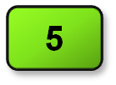
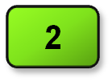
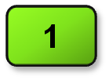
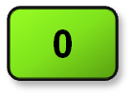
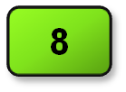
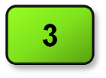
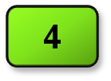

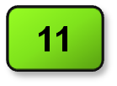

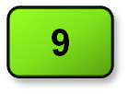

Solution (Contd.)
Start
Let us see the dry run of the flowchart.
numeric nNum, nOdd, nEven, nCtr
nNum
nCtr
nOdd
nEven
nCtr = 1, nOdd = 0, nEven = 0
Accept nNum
Is nNum % 2 = 0 ?
Yes
nEven = nEven + 1
No
nOdd= nOdd + 1
nCtr= nCtr + 1
Yes
Is nCtr <= 5 ?
No
A
Notes:
Explain the meaning of pseudocode. Using the example of adding two numbers explain how easily an pseudocode can be rewritten to program using a specific programming language.

Slide 7

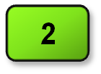
Solution (Contd.)
A
nOdd
nEven
Display nOdd
Display nEven
Stop
Notes:
Explain the meaning of pseudocode. Using the example of adding two numbers explain how easily an pseudocode can be rewritten to program using a specific programming language.

Slide 8
Solution (Contd.)
Let us now see the pseudocode for the flowchart.
begin
  numeric nNum, nOdd, nEven, nCtr
  nCtr = 1, nOdd = 0, nEven = 0
  repeat
  begin
  accept nNum
  if nNum %2 == 0
  begin
  nEven = nEven + 1
  end
  else
  begin
  nOdd = nOdd + 1
  end
  nCtr = nCtr + 1
  end until (nCtr <= 5)
  end
Notes:
Explain the meaning of pseudocode. Using the example of adding two numbers explain how easily an pseudocode can be rewritten to program using a specific programming language.

Slide 9
Solution (Contd.)
display nOdd
  display nEven
  end
Notes:
Explain the meaning of pseudocode. Using the example of adding two numbers explain how easily an pseudocode can be rewritten to program using a specific programming language.

